Slide 1
DIGITAL LOGIC DESIGN
EE(109)
LECTURE-31
DATE: 17TH APRIL, 2018

Slide 2
Chapter No:7
Latches and Flip Flop

Slide 3
TOPICS
1. Latches
2. Flip-Flops
3. Flip-Flop Operating Characteristics
4. Flip-Flop Applications

Slide 4


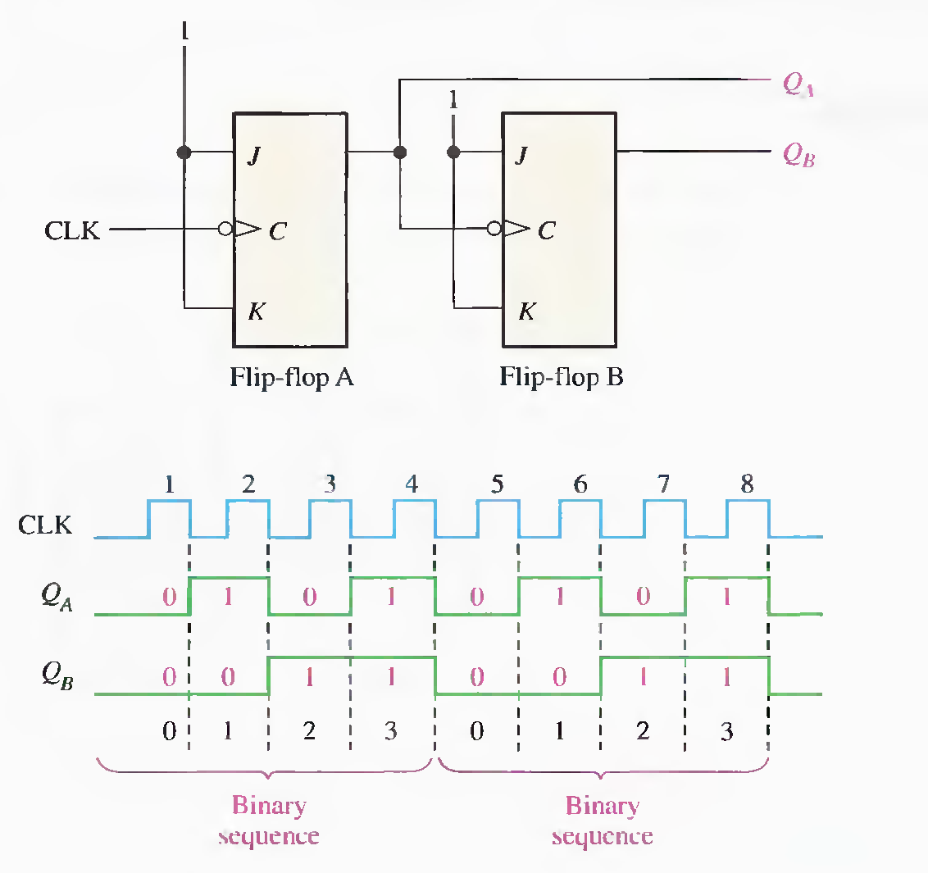

Slide 5
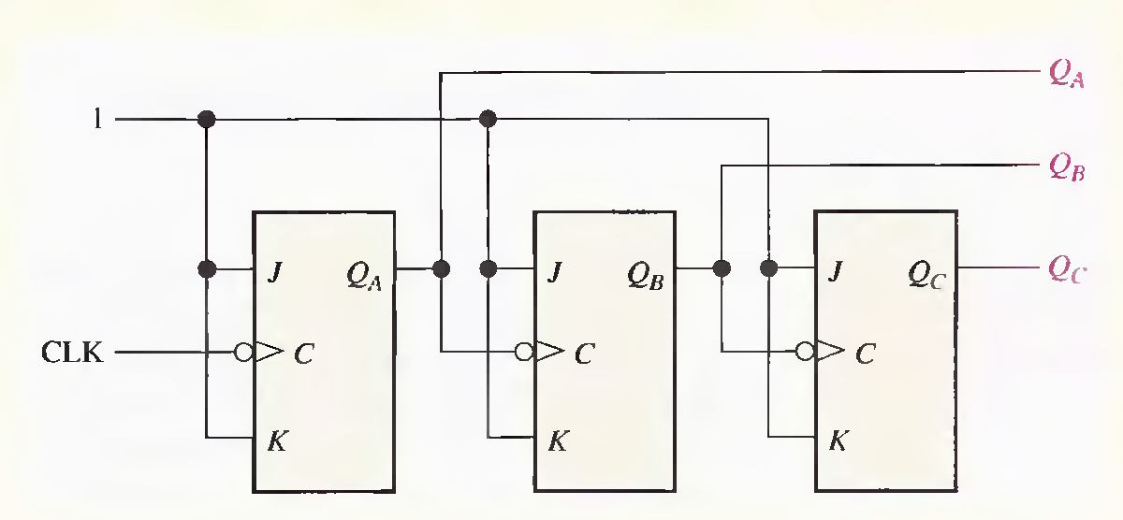
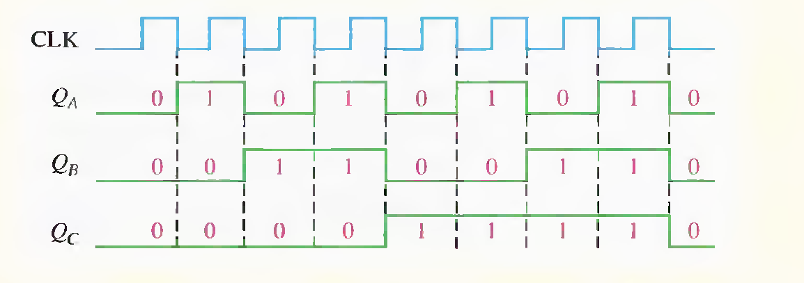

Slide 6
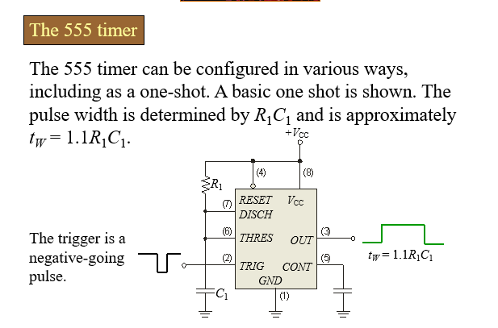


Slide 7
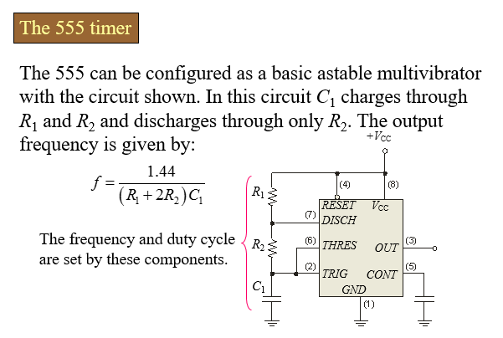

Slide 8
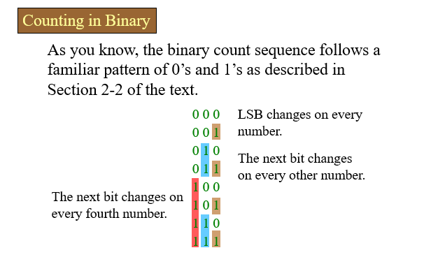

Slide 9
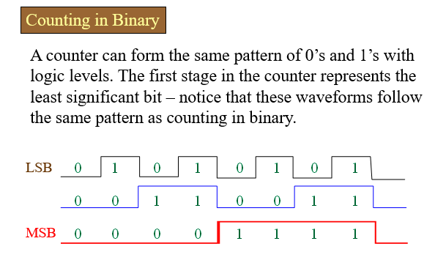

Slide 10


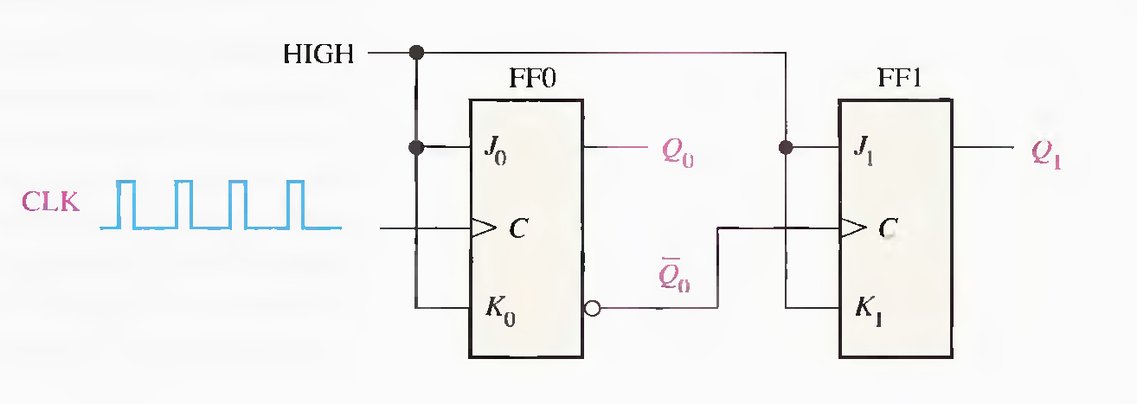
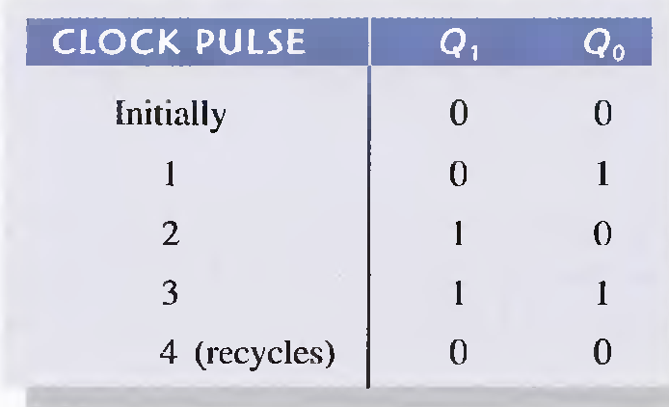
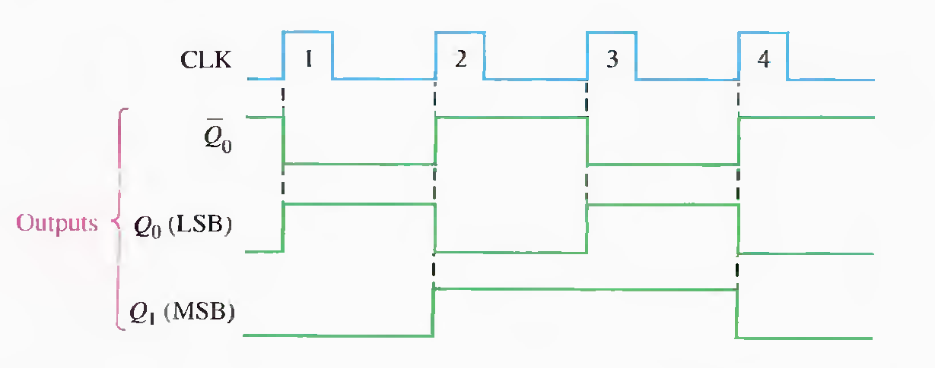

Slide 11
